Slide 1


SoC FPGA implementation of
Hopfield Neural Network
for solving the
Shortest Path Problem
Agustin Silva

Slide 2
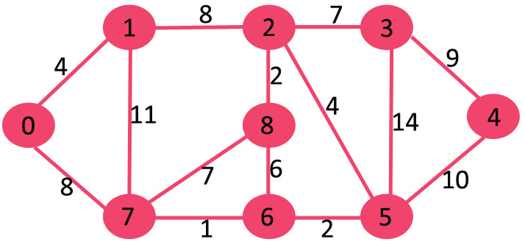


Slide 3
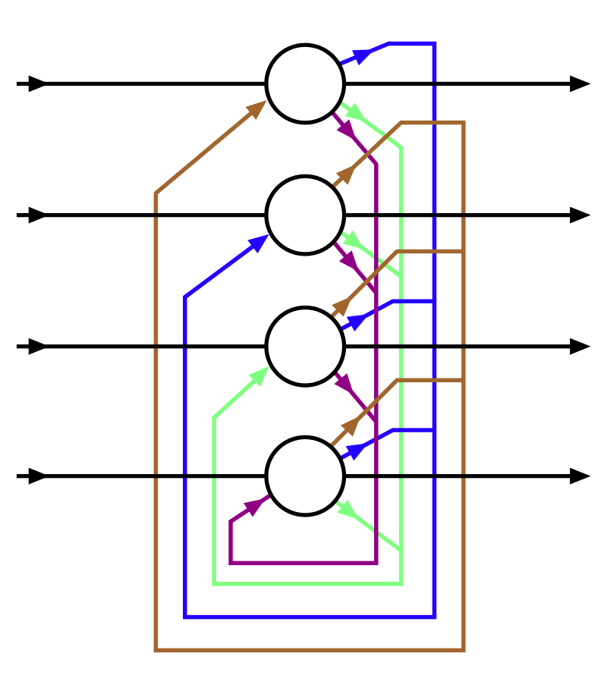


Slide 4
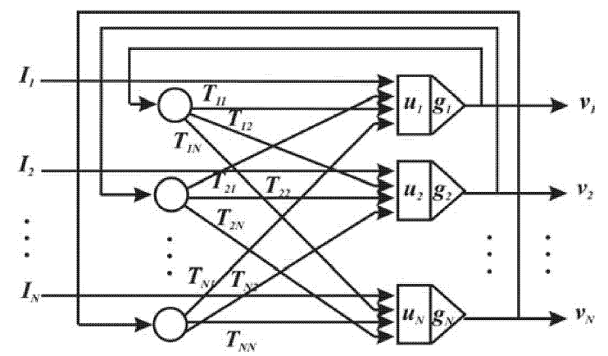
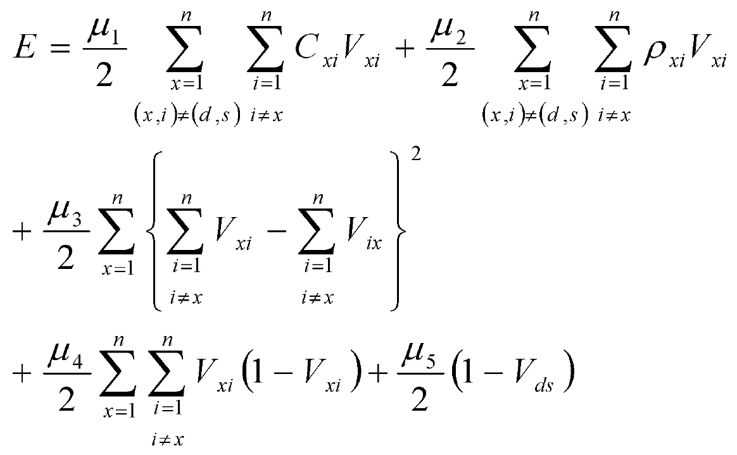

Slide 5
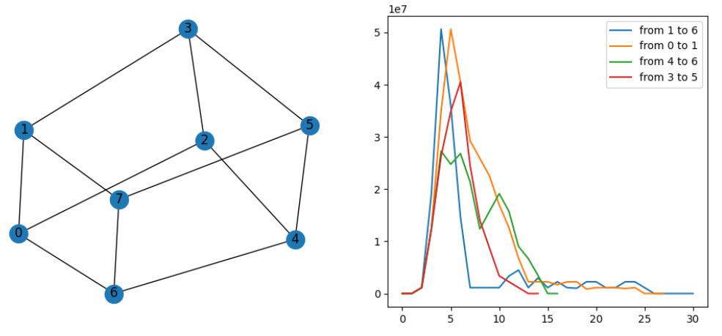

Slide 6
